Slide 1

Software Engineering
05 – Software Quality and Measurement Metrics
Dr. Seyed Reza Shahamiri More Info

Slide 2

Software Quality
2
Quality attribute requirements are part of an application’s non-functional requirements, which capture the many facets of how the functional requirements of an application are achieved.
A common problem with these quality requirements is that users or customers often propose them as general goals, such as ease of use, the ability of the system to recover from failure, or rapid user response.

Slide 3
Software Quality
However, goals are difficult to be verified as they are subjective.
For example, the following system goal is typical of how a manager might express usability requirements:
The system should be easy to use by medical staff and should be organized in such a way that user errors are minimized.

Slide 4
Software Quality Measurable Quality Requirements
4
Quality attribute requirements must be specific about how an application should achieve a given need:
You should write quality requirements quantitatively so that they can be objectively tested and measured.
The previous example can be written quantitatively as:
Medical staff shall be able to use all the system functions after four hours of training. After this training, the average number of errors made by experienced users shall not exceed two per hour of system use.

Slide 5
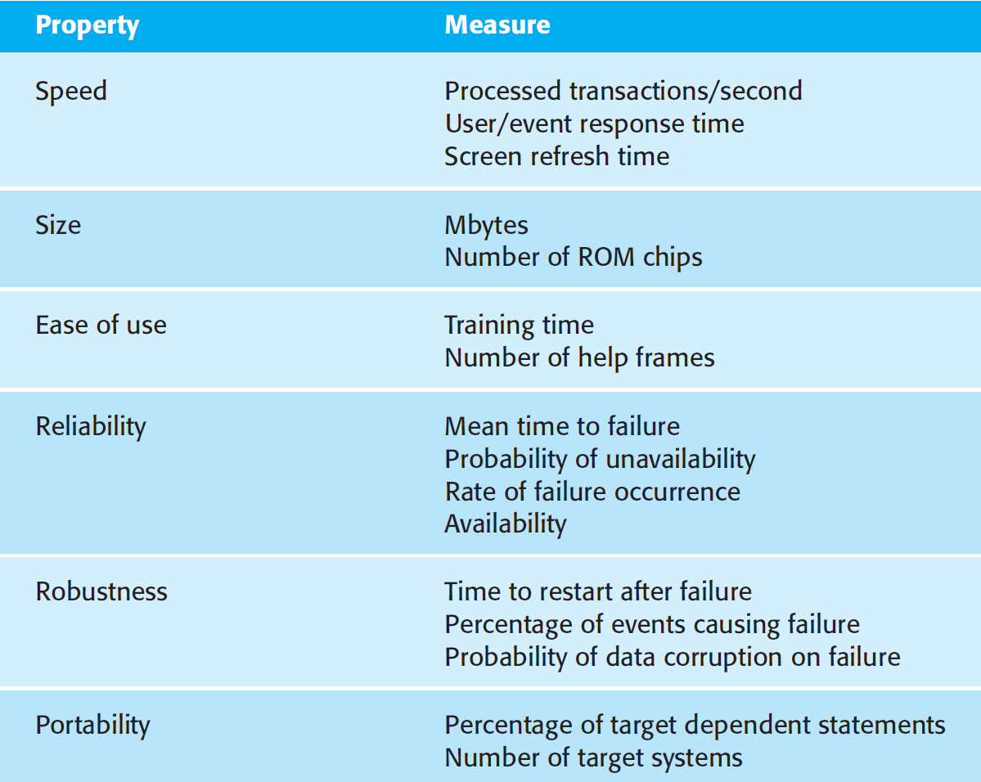
Software Quality Measurable Quality Requirements How To Define?
5
You can use the following metrics in order to specify non-functional system properties:

Slide 6
Software Quality
6
Software quality is not just about whether the software functionality has been correctly implemented, but also depends on non-functional system attributes.
The assessment of software quality is sometimes a subjective process where the quality management team has to use their judgment to decide if an acceptable level of quality has been achieved.
This is because some software properties, such as maintainability, cannot directly be measured.
Anyways, the quality management team has to consider whether or not the software is fit for its intended purpose.

Slide 7
Software Quality
7
The quality management team can decide of the software quality by answering questions about the system’s characteristics. For example:
Have programming and documentation standards been followed in the development process?
Has the software been properly tested?
Is the software sufficiently dependable to be put into use?
Is the performance of the software acceptable for normal use?
Is the software usable?
Is the software well structured and understandable?

Slide 8
Software Quality
8
In order to answer the previous questions and measure the quality of software, the quality assurance team relies on the results of software testing.
Hence they have to ensure that testing has been conducted properly.

Slide 9
Software Quality Attributes Performance
9
A performance quality requirement defines a metric that states the amount of work an application must perform in a given time, and/or deadlines that must be met for correct operation.

Slide 10
Software Quality Attributes Performance Measurements
10
Throughput: Throughput is a measure of the amount of work an application must perform in unit time. Work is typically measured in transactions per second (tps), or messages processed per second (mps).
Response Time: This is a measure of the latency an application exhibits in processing a business transaction. Response time is most often (but not exclusively) associated with the time an application takes to respond to some input.
Deadlines: Sometimes software systems require to complete tasks by specific deadlines. In general, any application that has a limited window of time to complete will have a performance deadline requirement.

Slide 11
Software Quality Attributes Scalability
11
Scalability is the ability of a system or process to handle a growing amount of work in a capable manner or its ability to be enlarged to accommodate that growth.
Scalability is about how a design can cope with some aspect of the application’s requirements increasing in size.
For example:
A scalable online transaction processing system or database management system is one that can be upgraded to process more transactions by adding new processors, devices and storage, and which can be upgraded easily and transparently without shutting it down.

Slide 12
Software Quality Attributes Modifiability
12
Modifications to a software system during its lifetime are simply a fact of life.
The modifiability quality attribute is a measure of how easy it may be to change an application to cater for new functional and nonfunctional requirements.
Predicting modifiability requires an estimate of effort and/or cost to make a change.
A proper software process, such as an Agile method, can increase modifiability.

Slide 13
Software Quality Attributes Security
13
The most common security-related attributes are:
Authentication: Applications can verify the identity of their users and other applications with which they communicate.
Authorization: Authenticated users and applications have defined access rights to the resources of the system.
Encryption: The messages sent to/from the application are encrypted.
Integrity: This ensures the contents of a message are not altered in transit.
Nonrepudiation: The sender of a message has proof of delivery and the receiver is assured of the sender’s identity.

Slide 14
Software Quality Attributes Availability
14
Availability is the proportion of time a system is in a functioning condition.
Availability is related to an application’s reliability.
Failures in applications cause them to be unavailable.
Failures impact on an application’s reliability, which is usually measured by the mean time to failures.

Slide 15
Software Quality Attributes Availability Recoverability
15
Recoverability is closely related to availability.
An application is recoverable if it has the capability to re-establish required performance levels and recover affected data after an application or system failure.

Slide 16
Software Quality Attributes Portability
16
Portability: Can an application be easily executed on a different software/ hardware platform to the one it has been developed for?
Portability depends on the choices of software technology used to implement the application, and the characteristics of the platforms that it needs to execute on.
Easily portable code bases will have their platform dependencies isolated and encapsulated in a small set of components that can be replaced without affecting the rest of the application.

Slide 17
Software Quality Attributes Testability
17
Testability: How easy or difficult is an application to test?
Early design decisions can greatly affect the amount of test cases that are required.
As a rule of thumb, the more complex a design, the more difficult it is to thoroughly test.
Simplicity tends to promote ease of testing.
Likewise, writing less of your own code by incorporating pretested components reduces test effort.

Slide 18
Software Quality Attributes Supportability
18
Supportability: This is a measure of how easy an application is to support once it is deployed.
Support typically involves diagnosing and fixing problems that occur during application use.
Supportable systems tend to provide explicit facilities for diagnosis, such as application error logs that record the causes of failures.
They are also built in a modular fashion so that code fixes can be deployed without severely inconveniencing application use.

Slide 19
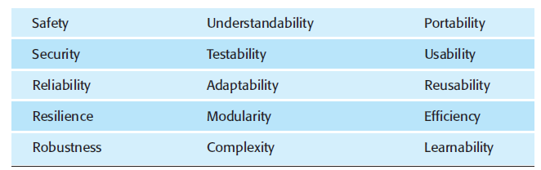
Software Quality Attributes
19

Slide 20
Software Quality Attributes
20
It is not possible for any system to be optimized for all of the quality attributes as some of them contradict each other.
For example, improving robustness may lead to loss of performance.
A quality plan should therefore define the most important quality attributes for the software that is being developed.
For example, it may be that efficiency is critical and other factors have to be sacrificed to achieve this.

Slide 21
Software Measurement
21
Software measurement is concerned with deriving a numeric value or profile for an attribute of a software component, system, or process.
By comparing these values to each other and to the standards that apply across an organization, you may be able to draw conclusions about the quality of software, or assess the effectiveness of software processes, tools, and methods.

Slide 22
Software Measurement Software Metrics
22
Using software measurement, a system could ideally be assessed using a range of metrics and, from these measurements, a value for the quality of the system could be inferred.
A software metric is a characteristic of a software system, system documentation, or development process that can be objectively measured.

Slide 23
Software Measurement Software Metrics
23
Examples of metrics:
The size of a product in lines of code
The number of reported faults in a delivered software product
The number of person-days required to develop a system component
Software metrics may be either control metrics or predictor metrics.

Slide 24
Software Measurement Software Metrics
24
Software Metrics
Control (Process)
Predictor (Product)
Static
Dynamic
Fan In/Fan Out
Cyclomatic Complexity
Length of Identifiers
Depth of Conditional Nesting
Fog Index
Average Effort
Time to Repair
Number of Reported Bugs
Computation Completion Time

Slide 25
Software Measurement Software Metrics Control Metrics
25
Control metrics or process metrics support process management and are usually associated with software processes.
Examples of control or process metrics are the average effort and the time required to repair reported defects.
Managers use process measurements to decide if process changes should be made.

Slide 26
Software Measurement Software Metrics Predictor Metrics
26
Predictor metrics help you predict characteristics of the software and are associated with the software itself and are sometimes known as product metrics.
Examples of predictor metrics are:
The Cyclomatic Complexity of a module
The average length of identifiers in a program
The number of attributes and operations associated with object classes in a design.
Managers use predictor metrics to help estimate the effort required to make software changes.

Slide 27
Software Measurement Software Metrics Product Metrics
27
Product metrics are predictor metrics that are used to measure internal attributes of a software system.
Product metrics fall into two classes:
Dynamic metrics
Static metrics

Slide 28
Software Measurement Software Metrics Product Metrics
28
Dynamic metrics:
They are collected by measurements made of a program in execution.
These metrics can be collected during system testing or after the system has gone into use.
Dynamic metrics help to assess the efficiency and reliability of a program.
An example might be the number of bug reports or the time taken to complete a computation.

Slide 29
Software Measurement Software Metrics Product Metrics
29
Static metrics:
They are collected by measurements made of representations of the system, such as the design, program, or documentation.
Static metrics help assess the complexity, understandability, and maintainability of a software system or system components.
Examples of static metrics are the code size and the average length of identifiers used.

Slide 30
Software Measurement Software Metrics Static Metrics
30
Fan-in:
Fan-in is a measure of the number of functions or methods that call another function or method (say X).
To put it simple, Fan-in of function X is the number of other functions that call X .
A high value for fan-in means that X is tightly coupled to the rest of the design and changes to X will have extensive knock-on effects.
A
B
C
X

Slide 31
Software Measurement Software Metrics Static Metrics
31
Fan-out:
Fan-out is the number of functions that are called by function X.
A high value for fan-out suggests that the overall complexity of X may be high because of the complexity of the control logic needed to coordinate the called components.
A
B
C
X

Slide 32
Software Measurement Software Metrics Static Metrics
32
Cyclomatic complexity
This is a measure of the control complexity of a program based on the program’s control graph.
It directly measures the number of linearly independent paths through a program's source code.

Slide 33
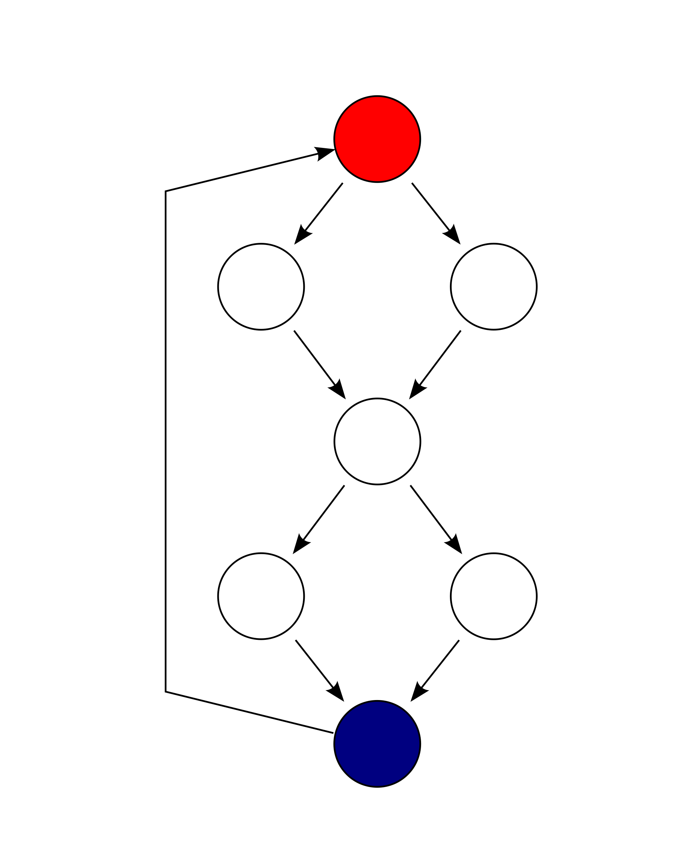
Control Flow Graph
33
Nodes: Statement of the program
Linear sequences of statements (block, segment) can be presented as a single node.
If the first statement of the sequence is executed, all further statements of the sequence will also be executed.
Edges: Possible execution sequences of the statements, represented by the nodes.
Nodes with several outgoing edges represent the statements that control the flow.
IF-statements and loop statements: Two outgoing edges.
CASE-statements: several outgoing edges.
There is exactly one start node at the beginning of a program, or head of the method and exactly one end node at the end of the program or method.

Slide 34
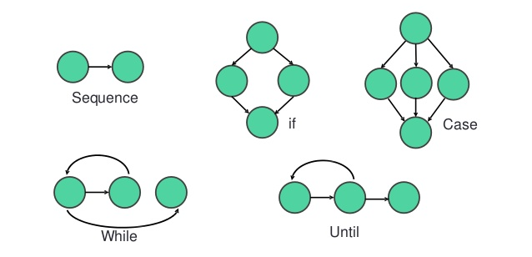
Control Flow Graph
34

Slide 35
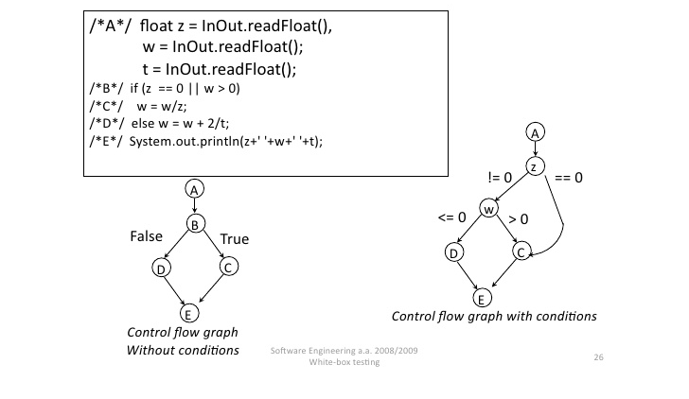
Control Flow Graph Example
35

Slide 36
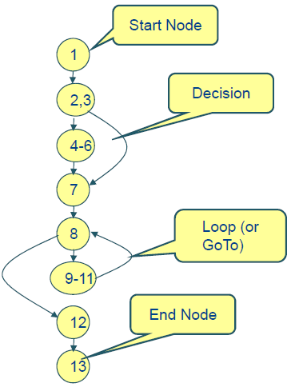
Control Flow Graph Activity 1
36
1. public int euclid1 (int m, int n) {
2. int r;
3. if (n > m) {
4. r = m;
5. m = n;
6. n = r;
}
7. r = m % n;
8. while (r != 0) {
9. m = n;
10. n = r;
11. r = m % n;
}
12. return n;
13. }

Slide 37
Control Flow Graph Activity 2
37
1
1. public int euclid2 (int m, int n) {
2. int r;
3. double d=0;
4. for (int i=0;i<=10;i++) {
5. d+=m+n;
6. d*=i;
}
7. r = m % n;
8. if ( (d/2)>=m)
9. if ( (d/2)<n)
10. r=1;
11. else
12. r=0;
13. else
14. r=-1;
15. while (r != 0) {
16. m = n;
17. for (int j=0; j<m;j++)
18. n += r+j;
19. r = m % n;
}
20. return n;
21. }
2,3
18
4
17
19
5,6
14
16
7
10
15
20
21
8
9
12

Slide 38
Software Measurement Software Metrics Static Metrics
38
Cyclomatic complexity
It shows how many independent paths are in a program. More paths means the software is more complex.
G = (V,E)
e = |E(G)|, number of nodes
v = |V(G)|, number of edges
Cyclomatic Number: ν(G) = v-e+2
In test-slang: “McCabe-Metric“

Slide 39
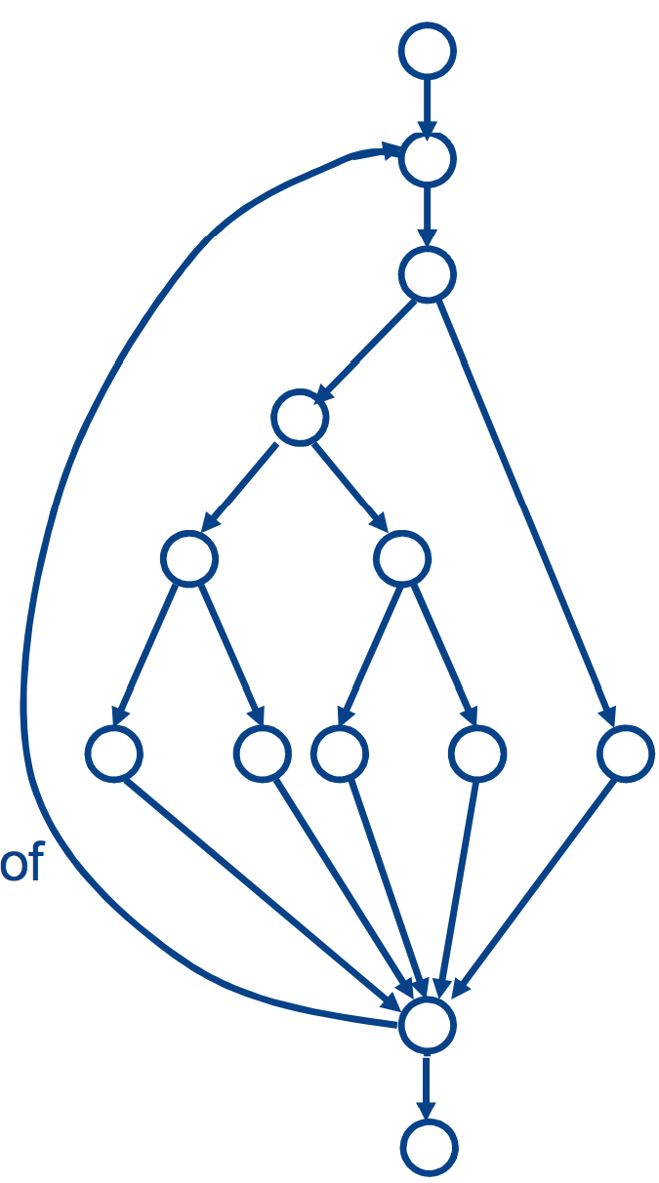
Software Measurement Software Metrics Cyclomatic Complexity
39
e = |E(G)| = 13
v = |V(G)| = 17
Cyclomatic Number:
ν(G) = 17-13+2 = 6
Cyclomatic number is also the number of decisions nodes in the control flow graph of a structured program +1, here: 5 (+ 1)
Example 2: What is the Cyclomatic complexity of the graph shown in slide 36?

Slide 40
Software Measurement Software Metrics Cyclomatic Complexity
40
1
2,3
What is the Cyclomatic complexity of this graph?
18
4
17
19
5,6
14
16
7
10
15
20
21
8
9
12

Slide 41
Software Measurement Software Metrics Evaluating Cyclomatic Complexity
41
A Cyclomatic number higher than 10 is, according to McCabe, not tolerable because it represents excessive complexity.
The understandability of a program piece is of vital importance for the maintainability.
Rework the program part!
The measured value of 6 in the example is in the acceptable area, according to McCabe.
The higher the determined cyclomatic number is, the more difficult it is to trace the application flow of the program piece and the more difficult it becomes to understand it.

Slide 42
Software Measurement Software Metrics Static Metrics
42
Length of identifiers:
This is a measure of the average length of identifiers (names for variables, classes, methods, etc.) in a program.
The longer the identifiers, the more likely they are to be meaningful and hence the more understandable the program.

Slide 43
Software Measurement Software Metrics Static Metrics
43
Depth of conditional nesting:
This is a measure of the depth of nesting of if-statements in a program.
Deeply nested if-statements are hard to understand and potentially error-prone.

Slide 44
Software Measurement Software Metrics Static Metrics
44
Fog index:
This is a measure of the average length of words and sentences in documents.
The higher the value of a document’s Fog index, the more difficult the document is to understand.

Slide 45
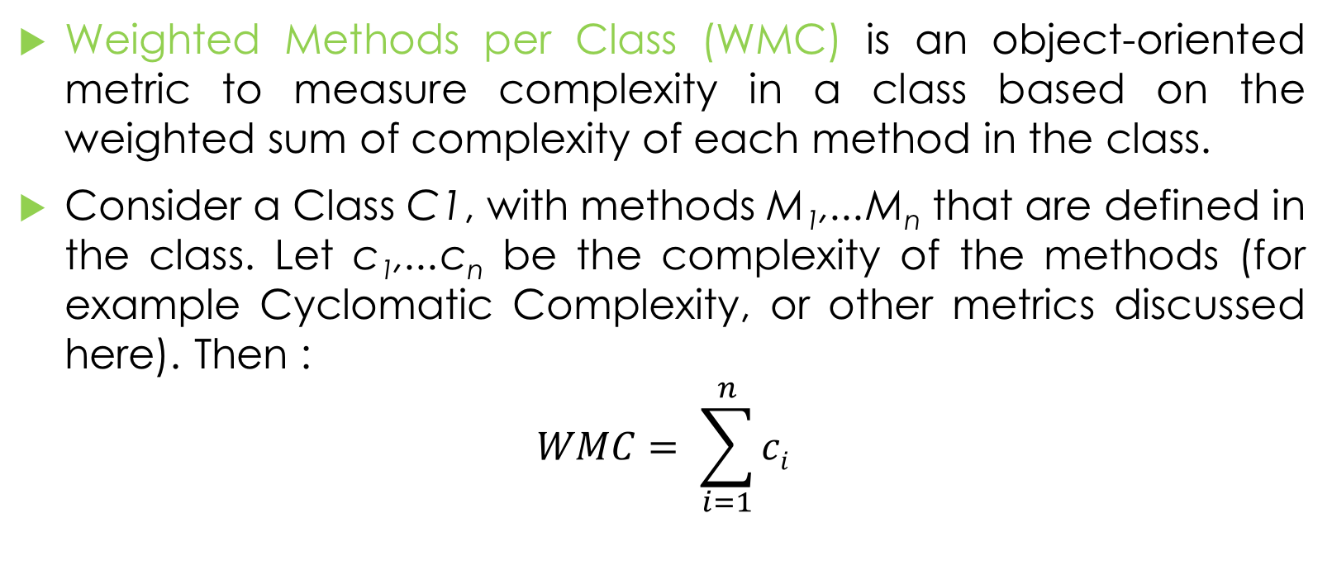
Software Measurement Object Oriented Software Metrics Weighted Methods per Class
45
Weighted Methods per Class (WMC) is an object-oriented metric to measure complexity in a class based on the weighted sum of complexity of each method in the class.
Consider a Class C1, with methods M₁,...M_{n} that are defined in the class. Let c₁,...c_{n} be the complexity of the methods (for example Cyclomatic Complexity, or other metrics discussed here). Then :
$$WMC= \sum_{i=1}^{n}{ci}$$

Slide 46
Software Measurement Object Oriented Software Metrics Weighted Methods per Class
46
WMC is an indicator of how much effort is required to develop and maintain a particular class.
A class with a disproportionately high number of complex methods (i.e. high WMC):
is more likely to be prone to errors,
has more impact on the children of the class,
is more likely to become application-specific and therefore less reusable.

Slide 47
Software Measurement Object Oriented Software Metrics Weighted Methods per Class
47
The lower limit for WMC is default 1 because a class should consist of at least one function and the upper default limit is 50 (if Cyclomatic Complexity is the basis).
If the complexity seems disproportionately high compared to the complexity of other classes, look at ways to split the class, by moving some of the methods into another class.

Slide 48
Software Measurement Object Oriented Software Metrics Depth in Inheritance Tree
48
The Depth in Inheritance Tree (DIT) is the depth of inheritance of the class (i.e. number of ancestors in direct lineage) in the object-oriented paradigm. For example:
DIT (C0) = 0
DIT (C0’) = 0
DIT (C1) = 1
DIT (C2) = 2
DIT (C3) = 3
DIT (C4) = 4

Slide 49
Software Measurement Object Oriented Software Metrics Depth in Inheritance Tree
49
DIT is predicated on three fundamental assumptions:
The deeper a class in the hierarchy, the greater the number of methods it will probably inherit which makes it harder to predict its behaviour.
Deeper trees involve greater design complexity since more classes and methods are involved.
Deeper classes in the tree have a greater potential for reusing inherited methods. Assumptions 1 and 2 tell us that having a higher number for depth is bad.
If that is where it ended we would be in good shape; however assumption 3 indicates that a higher number for depth is good for potential code reuse.

Slide 50
Software Measurement Object Oriented Software Metrics Depth in Inheritance Tree
50
A low number for depth implies less complexity but also the possibility of less code reuse through inheritance.
A high number for depth implies more potential for code reuse through inheritance but also higher complexity with a higher probability of errors in the code.

Slide 51
Software Measurement Object Oriented Software Metrics Number of Children
51
Number of Children (or Number of Direct Subclasses) NOC measures the number of direct subclasses of a class.
The size of NOC approximately indicates how an application reuses itself.
It is assumed that the more children a class has, the more responsibility there is on the maintainer of the class not to break the children's behaviour. As a result, it is harder to modify the class and requires more testing.
The upper recommended limit for a class is 10 and the lower limit is 0.
If NOC exceeds 10 children for a class, this may indicate a misuse of subclassing.

Slide 52
Software Measurement Object Oriented Software Metrics Coupling Between Objects
52
Coupling Between Objects (CBO) is a count of the number of classes that are coupled to a particular class i.e. where the methods of one class call the methods or access the attributes of the other.
These calls need to be counted in both directions so the CBO of class A is the size of the set of classes that class A references and those classes that reference class A.
Since this is a set - each class is counted only once even if the reference operates in both directions i.e. if A references B and B references A, B is only counted once. To put it differently, it is not the number of times A references B.
Note that inheritance associations not counted in CBO.

Slide 53
Software Measurement Object Oriented Software Metrics Coupling Between Objects
53

Slide 54
54
Class Activity: calculate the CBOs for each class.

Slide 55
Software Measurement Object Oriented Software Metrics Coupling Between Objects
55
Class Activity: calculate the CBOs for A, B, D, E, C, and F.

Slide 56
Software Measurement Object Oriented Software Metrics Coupling Between Objects
56
CBO should be as low as possible for three reasons:
Increased coupling increases interclass dependencies, making the code less modular and less suitable for reuse. In other words if you want to package up the code for reuse you might end up having to include code that was not really fundamental to the core functionality.
More coupling means that the code becomes more difficult to maintain since an alteration to code in one area runs a higher risk of affecting code in another (linked) area. The more links between classes the more complex the code and the more difficult it will be to test.
The only consideration in calculating this metric is whether only the classes written for the project should be considered or whether library classes should be included too.

Slide 57
Software Measurement Object Oriented Software Metrics Response for Class
57
The Response for Class (RFC) is the "Number of Distinct Methods and Constructors invoked by a Class."
The response set of a class is the set of all methods and constructors that can be invoked as a result of a message sent to an object of the class. This set includes the methods in the class, inheritance hierarchy, and methods that can be invoked on other objects.

Slide 58
Software Measurement Object Oriented Software Metrics Response for Class
58
If a large number of methods can be invoked in response to a message, the testing and debugging of the class becomes more complicated since it requires a greater level of understanding required on the part of the tester.
The larger the number of methods that can be invoked from a class, the greater the complexity of the class.
A worst case value for possible responses will assist in appropriate allocation of testing time.
The RFC for a class should usually not exceed 50 although it is acceptable to have a RFC up to 100.

Slide 59
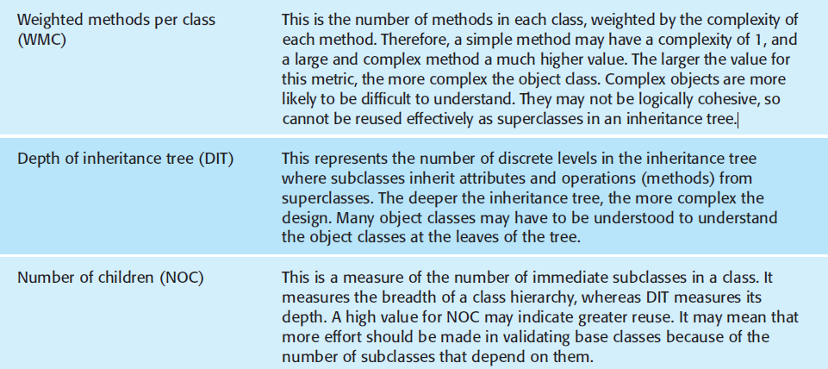
Software Measurement Object Oriented Software Metrics
59

Slide 60
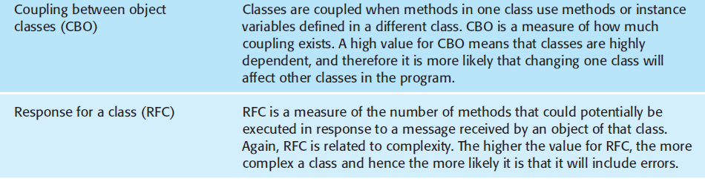
Software Measurement Object Oriented Software Metrics
60

Slide 61
Software Measurement Software Metrics Applications
61
There are two ways in which measurements of a software system may be used:
1. To assign a value to system quality attributes:
By measuring the characteristics of system components, such as their cyclomatic complexity, and then aggregating these measurements, you can assess system quality attributes, such as maintainability.
Note that not all software quality attributes can be directly measured because sometimes they are affected by subjective factors such as user experience and education.

Slide 62
Software Measurement Software Metrics Applications
62
There are two ways in which measurements of a software system may be used:
2. To identify the system components whose quality is substandard:
Measurements can identify individual components with characteristics that deviate from the norm.
For example, you can measure components to discover those with the highest complexity. These are most likely to contain bugs because the complexity makes them harder to understand.

Slide 63
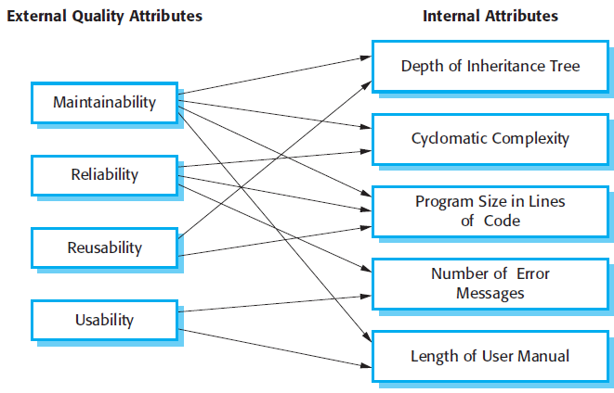
Software Measurement Software Metrics
63
Relationships between internal attributes (metrics) and software quality attributes are shown here.

Slide 64
Software Measurement Software Metrics
64

